Slide 1
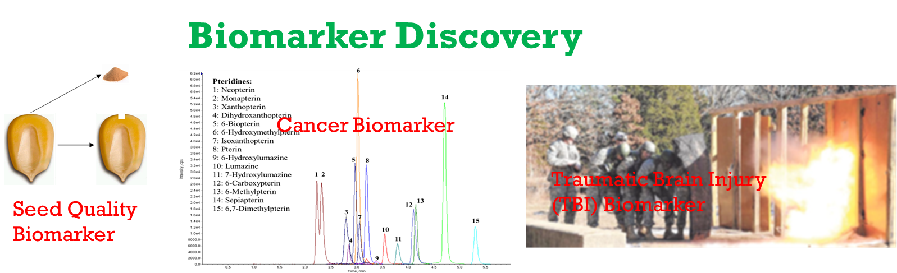
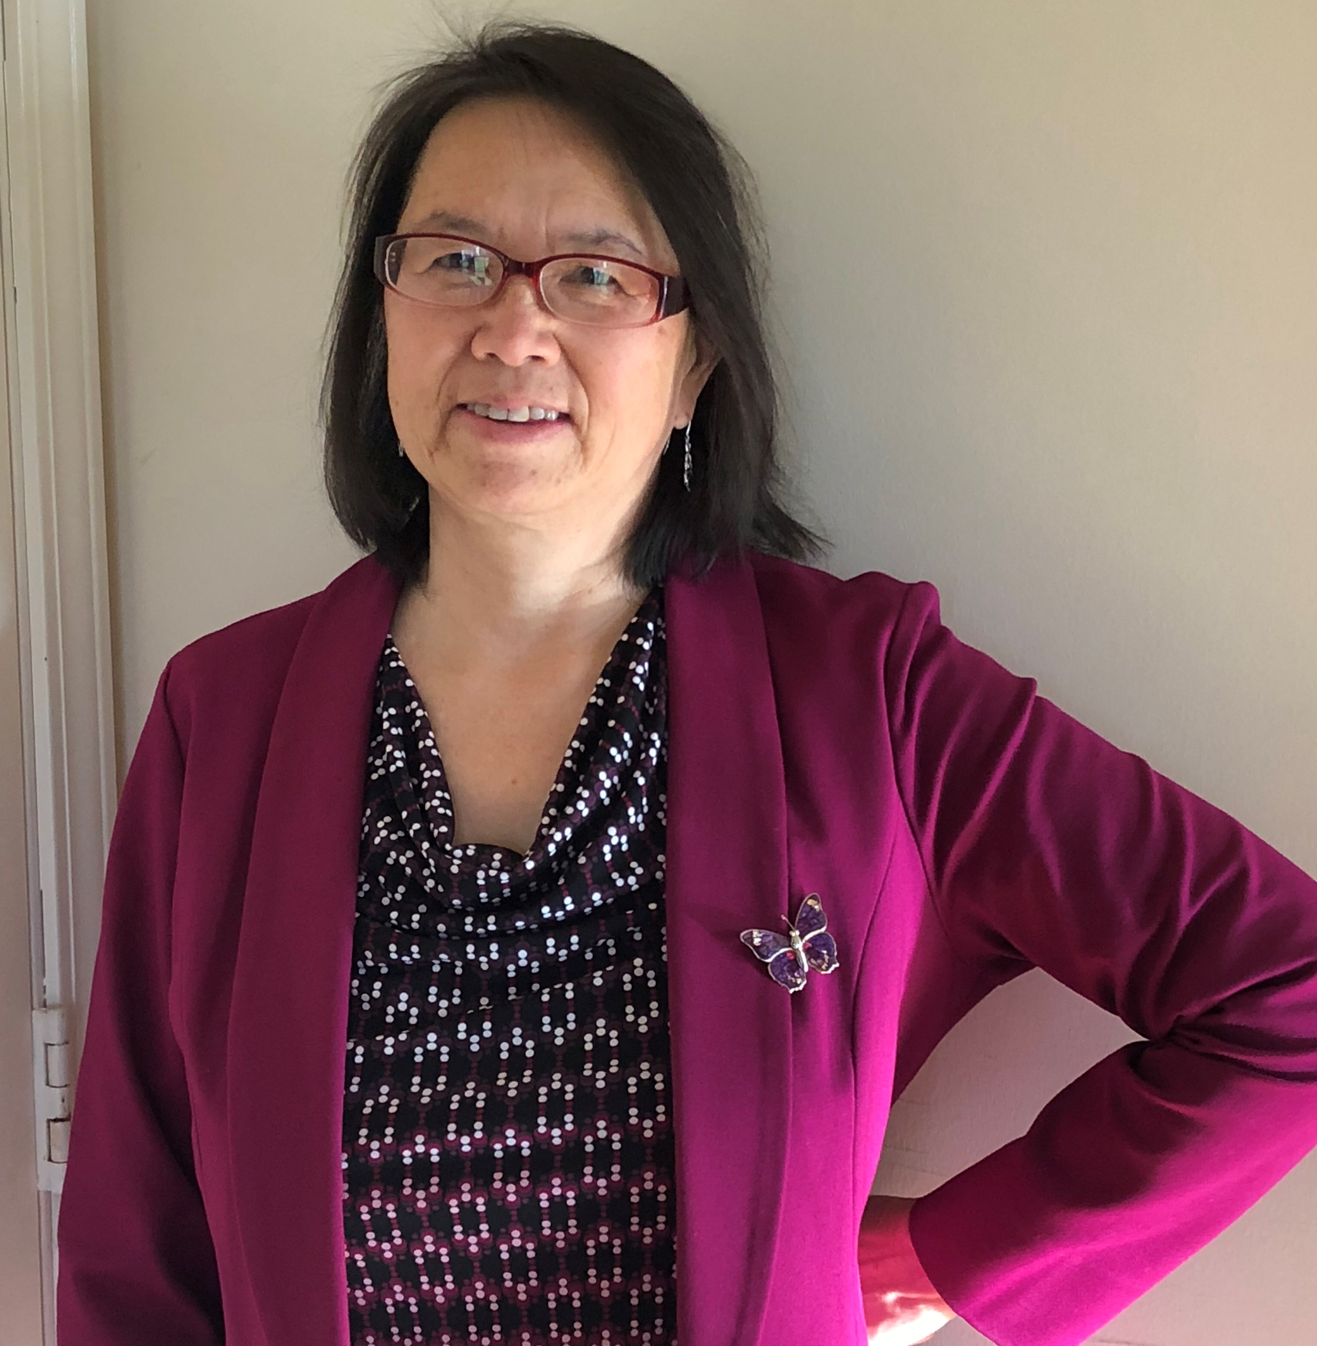
DEPARTMENT OF CHEMISTRY
Bioanalytical and Environmental Analyses
Research Focus
Development of analytical methods for applications in
life science, biomedicine, and environmental
pollutants
Drinking water quality monitoring and improvement
Biomarker discovery including cancer biomarker,
traumatic brain injury (TBI) biomarker, seed quality
biomarker, etc.
Nanoparticle characterization and quantification by
cutting edge single particle- and single cell-ICP-MS
and their novel applications in life science, food safety,
emerging environmental contaminant, etc.
Contact Information
Honglan Shi, Ph.D.
Research Professor
Department of Chemistry
Email: honglan@mst.edu
Phone: 573-341-4433
Research Funds
National Institute of Health
National Science Foundation
Missouri Department of Natural Resources
Environmental Protection Agency
Leonard Wood Institute (DoD)
Water treatment facilities
Industries
Keywords
Bioanalysis; advanced instrumental analysis; single cell- and single particle-ICP-MS, environmental contaminants; water disinfection byproducts (DBPs); harmful algal bloom; biomarker
Significant Achievements
Faculty achievement award, Missouri S&T, 2012, 2014, 2016
Total 46 peer reviewed journal publications in recent 5
years
Total >90 conference presentations in recent 5 years
One patent issued in year 2020
Potential Collaboration fields
Broad fields that need analytical quantification and
characterization; nanoparticle analysis; biomarker discovery

